Slide 1
Refactoring
Restructuring existing computer code
with C# Examples
Guilan University Computer Group
Student: Aryan Ebrahimpour

Slide 2

List of Content
What is refactoring?
Refactoring Tools for different technologies
What is clean coding?
What is technical debt?
Causes of technical debt
When to refactor?
How to refactor?
Code Smells
Bloaters
Long Method
Large Class
Primitive Obsession
Long parameter list
Data clumps
Object-orientation abusers
Alternative classes with different interfaces
Refused bequest
Switch statements
Temporary fields

Slide 3
List of Content
Code Smells
Change preventers
Divergent changes
Parallel inheritance hierarchies
Shotgun surgery
Dispensables
Comments
Duplicate code
Data class
Dead code
Lazy classes
Speculative generality
Couplers
Feature envy
Inappropriate intimacy
Incomplete library class
Message chains
Middle man
References

Slide 4
What is Refactoring?

Slide 5
What is refactoring?
Refactoring is a controllable process of improving code without creating new functionality. It transforms a mess into clean code and simple design.
improves nonfunctional attributes of the software
Advantages include:
improved code readability
reduced complexity
These can improve:
source-code maintainability
create a more expressive internal architecture or object model
improve extensibility
Typically, refactoring applies a series of standardized basic micro-refactorings, each of which is (usually) a tiny change in a computer program's source code
Notes:
Non-functional: Judge rather than behavior
Micro-refactor: even moving 2 line

Slide 6
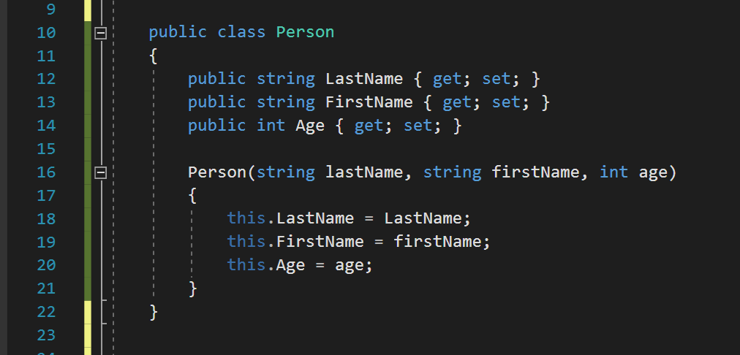
What is refactoring?

Slide 7
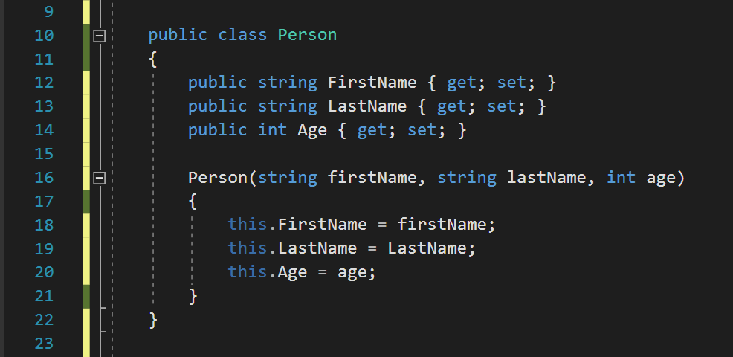
What is refactoring?

Slide 8
Refactoring Tools

Slide 9
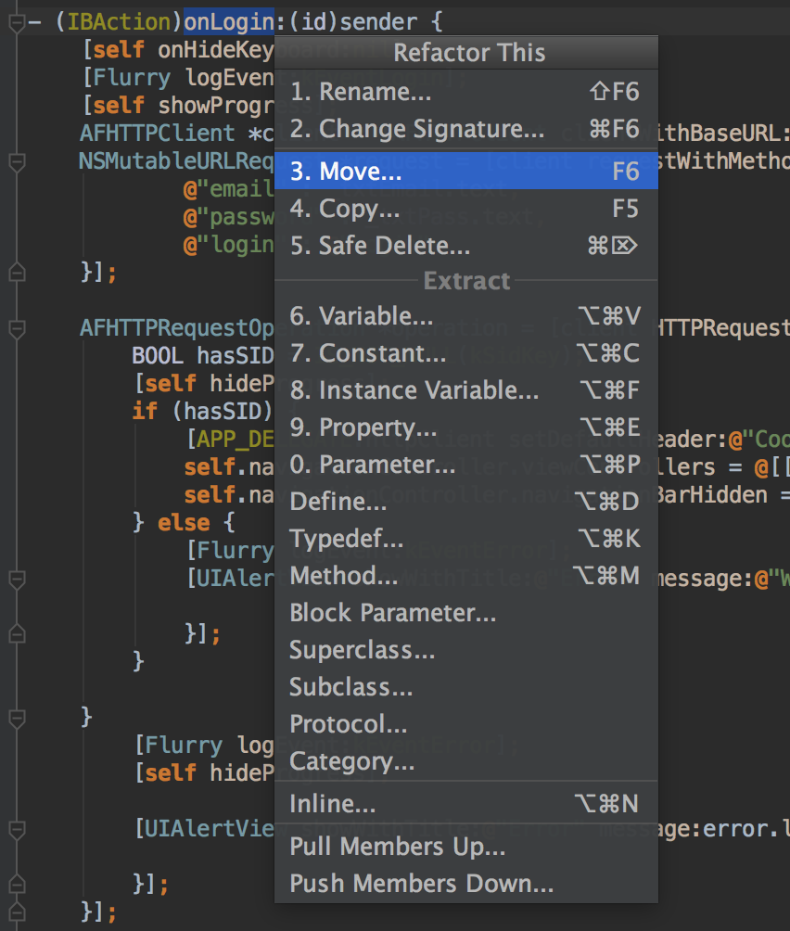
Refactoring Tools (1 / 9)
JetBrains AppCode for Objective-C, C and C++

Slide 10
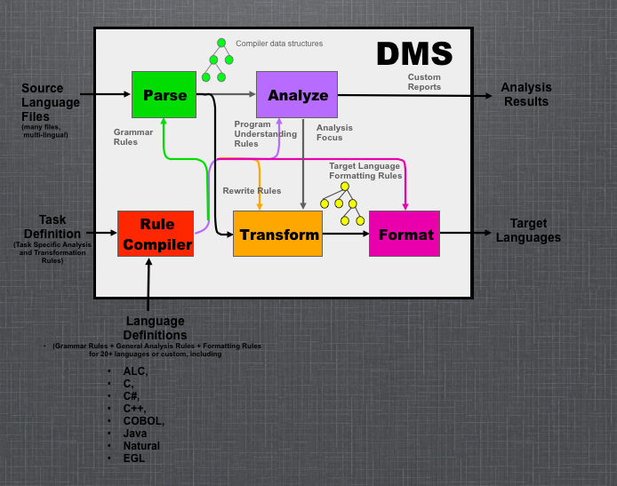
Refactoring Tools (2 / 9)
DMS Software Reengineering toolkit
C++
C#
Java
COBOL
SQL
HTML
Verilog
…

Slide 11
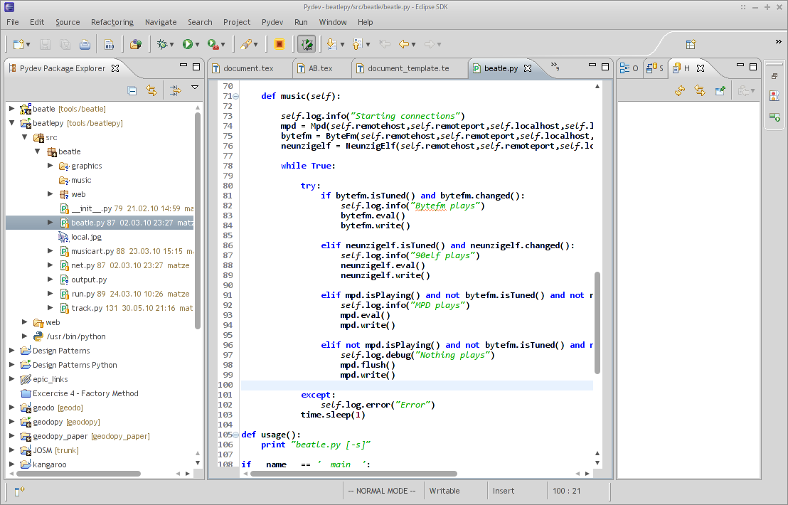
Refactoring Tools (3 / 9)
Eclipse Based
Eclipse (Java, PHP, Ruby , …)
PyDev (for Python)
Photran (a Fortran plugin for Eclipse)

Slide 12
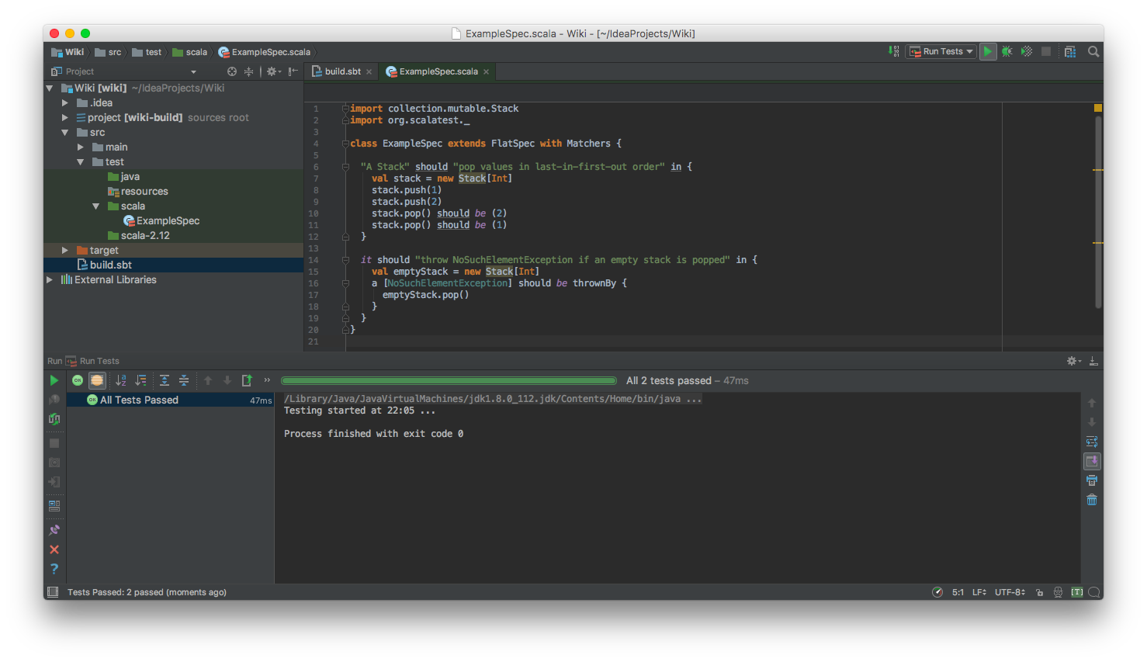
Refactoring Tools (4 / 9)
IntelliJ Based
IntelliJ IDEA (Java)
PyCharm (Python)
WebStorm (Js)
Android Studio (Java)

Slide 13
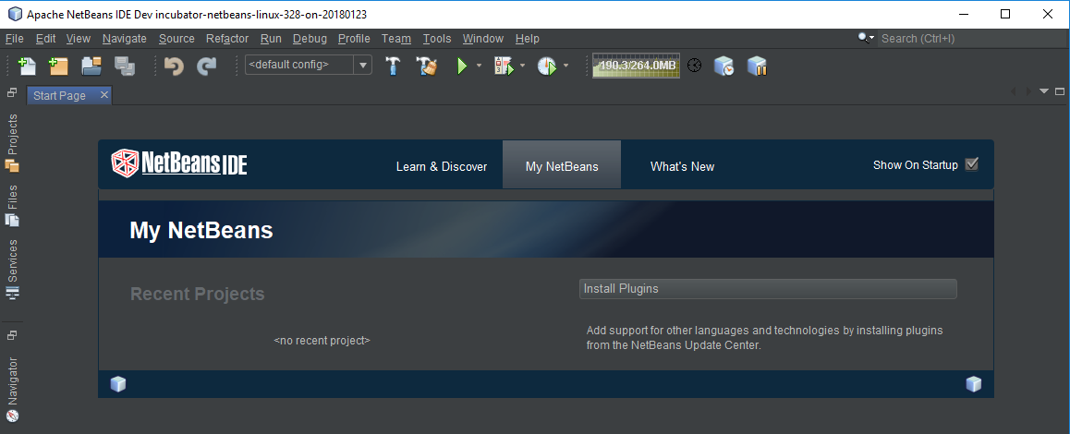
Refactoring Tools (5 / 9)
For Java
JDeveloper
NetBeans

Slide 14
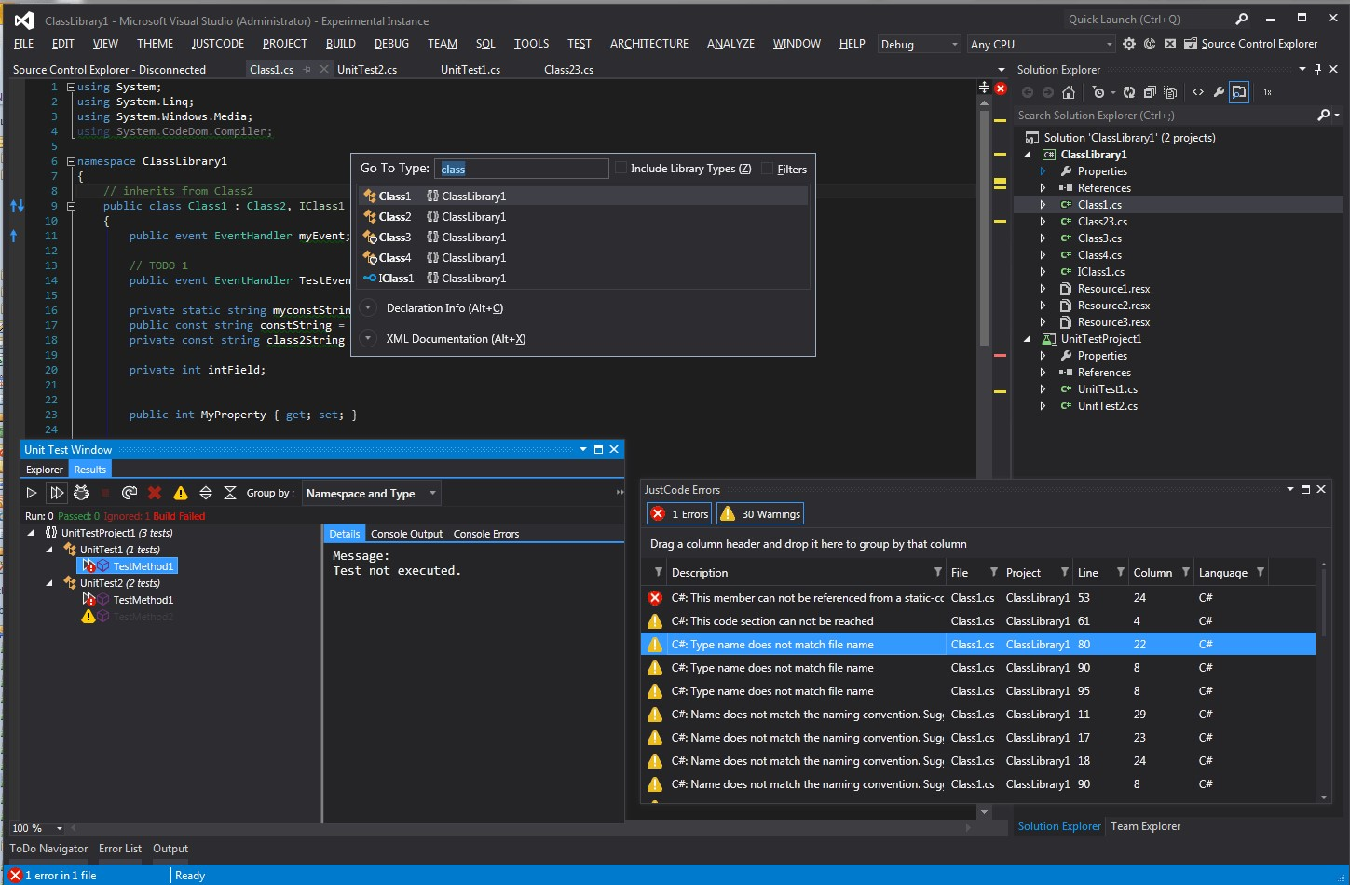
Refactoring Tools (6 / 9)
Visual Studio (for .NET and C++)

Slide 15
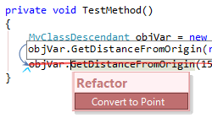
Refactoring Tools (7 / 9)
CodeRush (add-on for Visual Studio)

Slide 16
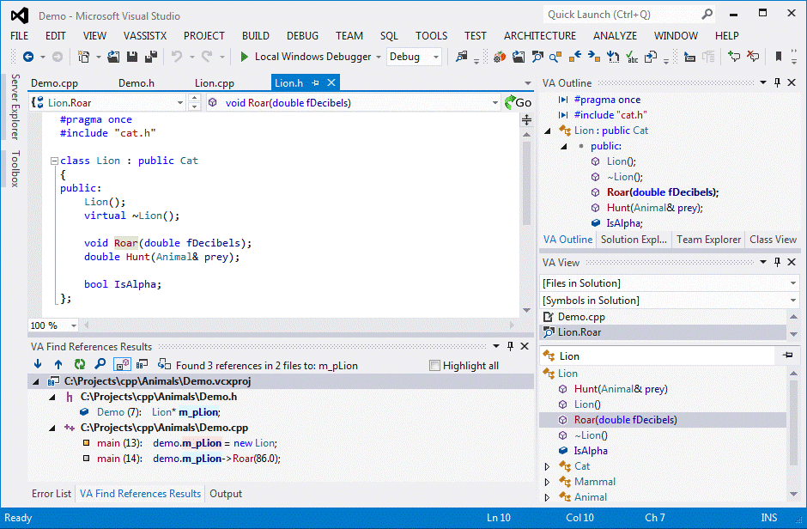
Refactoring Tools (8 / 9)
Visual Assist
add-on for Visual Studio with refactoring support for C# and C++

Slide 17
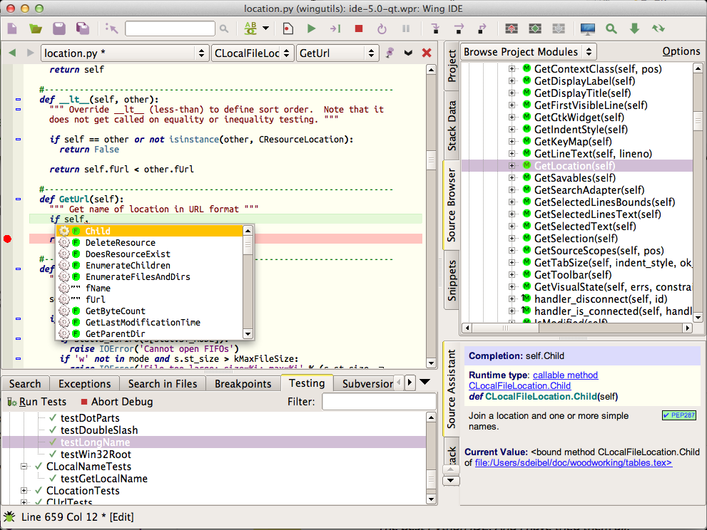
Refactoring Tools (9 / 9)
WING IDE (for Python)

Slide 18
Clean Coding

Slide 19
What is clean coding?
The main purpose of refactoring is to fight technical debt.
It transforms a mess into clean code and simple design.
But what is clean code, anyway? Here are some of its features.

Slide 20
What is clean coding?
1- Clean code is obvious for other programmers.
And I'm not talking about super sophisticated algorithms. Poor variable naming, bloated classes and methods, magic numbers -you name it- all of that makes code sloppy and difficult to grasp.
Notes:
Magic Number: number unexplained. Can replace with a constant name.

Slide 21
What is clean coding?
2- Clean code doesn't contain duplication.
Each time you have to make a change in a duplicate code, you have to remember to make the same change to every instance. This increases the cognitive load and slows down the progress.

Slide 22
What is clean coding?
3- Clean code contains a minimal number of classes and other moving parts.
Less code is less stuff to keep in your head.
Less code is less maintenance.
Less code is fewer bugs.
Code is liability, keep it short and simple.
Notes:
Liability مسئولیت دین

Slide 23
What is clean coding?
4- Clean code passes all tests.
You know your code is dirty when only 95% of your tests passed.
You know you're screwed when you test coverage is 0%.

Slide 24
What is clean coding?
5- Clean code is easier and cheaper to maintain!

Slide 25
Technical Debt

Slide 26
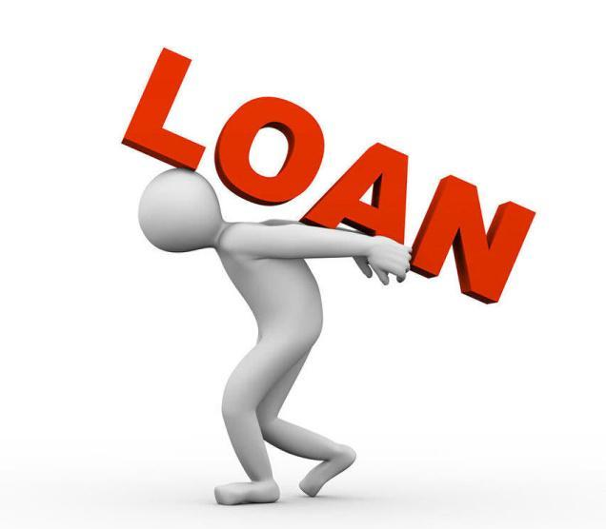
Technical debt
Everyone does their best to write excellent code from scratch.
There probably isn't a programmer out there who intentionally writes unclean code to the detriment of the project.
But at what point does clean code become unclean?
What is the term of “technical debt”?
If you get loan from the bank, you can make purchases faster.
You don't just pay off the principal, but also the additional interest on the loan.
Interest can exceed your total income, making full repayment impossible.
Same thing happens with code:
You can temporarily speed up without writing tests for new features
but this will gradually slow your progress every day until you eventually pay off the debt by writing tests
Notes:
Detriment: ضرر

Slide 27

Causes of technical debt
1- Business pressure.
Sometimes business circumstances might force you to roll out features before they are completely finished.
In this case, patches and crutches will appear in the code to hide the unfinished parts of the project.
Notes:
فشار تحویل پروژه
وصله های ناجور به پروژه

Slide 28
Causes of technical debt
2- Lack of understanding of the consequences of technical debt.
Sometimes your employer might not understand that technical debt has "interest" insofar as it slows down the pace of development as debt accumulates.
This can make it too difficult to dedicate the team's time to refactoring because management does not see the value of it.
Notes:
کارفرما متوجه عواقب قرض فنی نیست
نمیشه وقت تیم رو روی ریفکتور گذاشت

Slide 29
Causes of technical debt
3- Failing to combat the strict coherence of components.
This is when the project resembles a monolith rather than the product of individual modules.
In this case, any changes to one part of the project will affect others. Team development is made more difficult because it is difficult to isolate the work of individual members.
Notes:
پروژه یه غول بزرگه، به جای اینکه ارتباط قوی کامپوننت ها باشه.
تیم نمیتونه کار بکنه.

Slide 30
Causes of technical debt
4- Lack of tests.
The lack of immediate feedback encourages quick, but risky corrections (i.e. "crutches"), sometimes directly during the production phase.
The effects of this can be catastrophic. For example, an innocent hotfix might send a test email to the entire client database or delete the current customer data in the database.
Notes:
نبود تست: سریع اما ریسکی
نتایج مصیبت بار:
ارسال ایمیل به همه یا پاک شدن دیتا

Slide 31
Causes of technical debt
5- Lack of documentations.
This slows down the introduction of new people to the project and can grind development to a halt if key people leave the project.
Notes:
نبود اعضای اصلی پروژه، پروژه رو دچار بحران میکنه

Slide 32
Causes of technical debt
6- Lack of interaction between team members.
If the knowledge base is not distributed throughout the company, people will end up working with an outdated understanding of processes and information about the project.
This situation can be exacerbated when junior developers are incorrectly trained by their mentors.
Notes:
اگه پایگاه دانش توضیع نشه، دانش اعضای تیم قدیمیه.
وقتی رخ میده که برنامه نویسان جوان بد آموزش دیده باشن.

Slide 33
Causes of technical debt
7- Long-term simultaneous development in several branches.
This can lead to the accumulation of technical debt, which is then increased when changes are merged.
The more changes made in isolation, the greater the total technical debt.
Notes:
تغییرات کد زیاد در حالت ایزوله

Slide 34
Causes of technical debt
8- Delayed refactoring.
The project's requirements are constantly changing and at some point it may become obvious that parts of the code are obsolete, have become cumbersome, and must be redesigned to meet new requirements.
On the other hand, the project's programmers are writing new code every day that works with the obsolete parts. Therefore, the longer refactoring is delayed, the more dependent code will have to be reworked in the future.
Notes:
بخش هایی از کد Obsolete هست
از کد های قدیمی استفاده میشه
Cumbersome: سنگین

Slide 35
Causes of technical debt
9- Lack of compliance monitoring.
This happens when everyone working on the project writes code as they see fit (i.e. the same way they wrote the last project).
Notes:
مانیتور کردن انطباق فکری
هر کی هر جور دوست داره کد میزنه
مثل آخرین پروژه ای که انجام داده

Slide 36
Causes of technical debt
10- Incompetence.
This is when the developer just doesn't know how to write decent code.
Notes:
بی کفایتی
کد تمیز نوشتن بلد نیست

Slide 37
When to refactor?

Slide 38
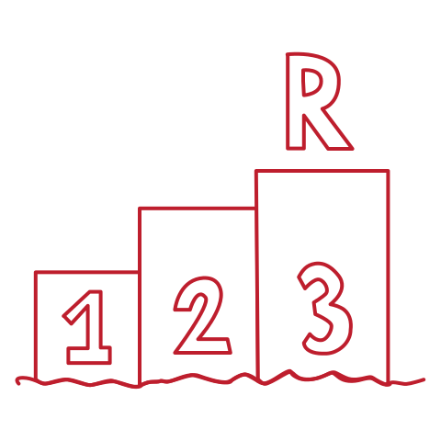
When to refactor?
Rules Of Three
When you are doing something for the first time, just get it done.
When you are doing something similar for the second time, cringe at having to repeat but do the same thing anyway.
When you are doing something for the third time, start refactoring.

Slide 39
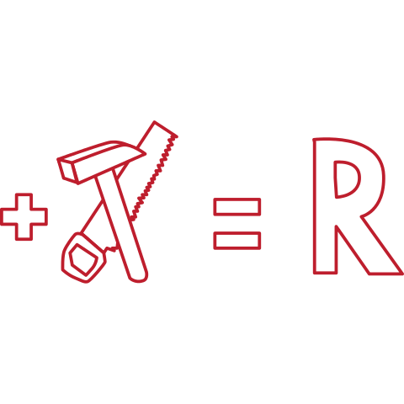
When to refactor?
When adding a feature
Refactoring helps you understand other people's code.
If you have to deal with someone else's dirty code, try to refactor it first.
Clean code is much easier to grasp.
You will improve it not only for yourself but also for those who use it after you.
Refactoring makes it easier to add new features.
It's much easier to make changes in clean code.
Notes:
اگه به کد کثیف یکی دیگه میخوای فیچر اضافه کنی
در کل تغییر کد تمیز راحت تره

Slide 40
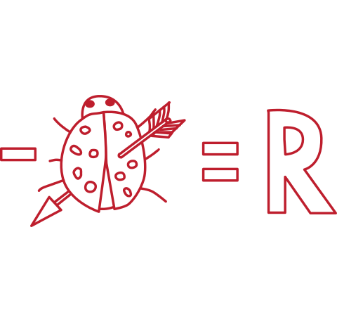
When to refactor?
When fixing a bug
Bugs in code behave just like those in real life: they live in the darkest, dirtiest places in the code. Clean your code and the errors will practically discover themselves.
Managers appreciate proactive refactoring as it eliminates the need for special refactoring tasks later. Happy bosses make happy programmers!
Notes:
باگ ها مثل باگ زندگی واقعی هستند.
خونه رو تمیز کن سوسکا پیدا میشن، کد رو تمیز کن باگا پیدا میشن

Slide 41
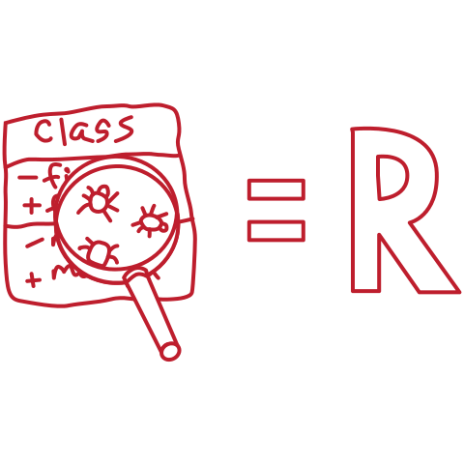
When to refactor?
During code review
The code review may be the last chance to tidy up the code before it becomes available to the public.
It's best to perform such reviews in a pair with an author. This way you could fix simple problems quickly and gauge the time for fixing the more difficult ones.
Notes:
آخرین شانس
بهترین حالت، دو نفره

Slide 42
How to refactor?

Slide 43
How to refactor?
Set of small changes each of which makes the existing code slightly better
Still leaving the program in working order.
Checklist of refactoring done right way:

Slide 44
When to refactor?
1- The code should become cleaner
If the code remains just as unclean after refactoring... you've just wasted an hour of your life.
Try to figure out why this happened.
This frequently happens when you move away from small changes to big changes.
In this case, It's very easy to lose your mind, especially if you have a time limit.
It can also happen when working with extremely sloppy code.
Whatever you improve, the code as a whole still remains a disaster.
Notes:
اگه کد تمیز نشد، وقتت رو تلف کردی
اگه تغییرات کوچیکو بزرگ کنی
اگه کد خیلی بد باشه

Slide 45
When to refactor?
2- New functionality should not be created during refactoring.
Do not mix refactoring and direct development of new features. Try to separate these processes at least within the confines of individual commits.

Slide 46
When to refactor?
3- All existing tests must pass after refactoring.
There are two cases when tests can break down after refactoring:
You made a mistake when changing the code.
This is easy - just go ahead and correct the mistake.
Your tests were too low-level (for example, testing private class methods).
In this case, the tests are to blame, and the only way to fix this is to refactor the tests themselves and write new, higher-level tests.
A great way to avoid this kind of situation is to write tests in the BDD style.
Notes:
LowLevel test: checking url for login, login button
BDD: Behavioral-driven development
Counter example: increase by one

Slide 47
Code Smells

Slide 48
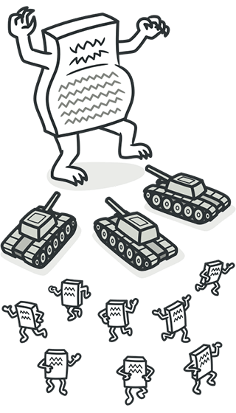
Code Smells
Bloaters
Bloaters are code, methods and classes that have increased to such gargantuan proportions that they are hard to work with. Usually these smells do not crop up right away, rather they accumulate over time as the program evolves (and especially when nobody makes an effort to eradicate them).
Notes:
عظیم الجثه ها
سریع و راحت درست نمیشن و زمان نیاز دارن

Slide 49
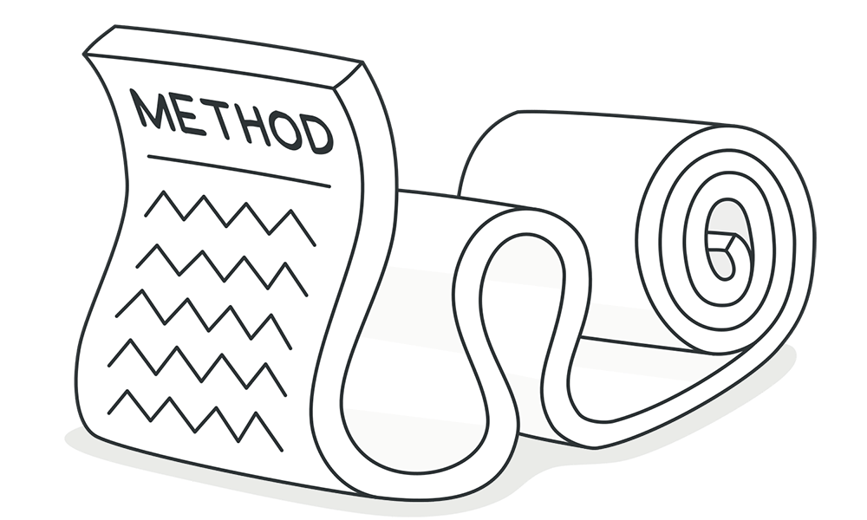
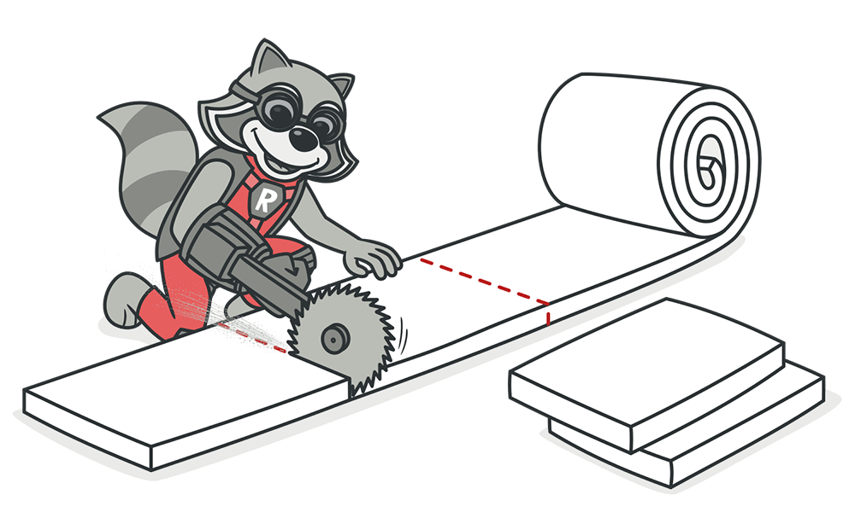
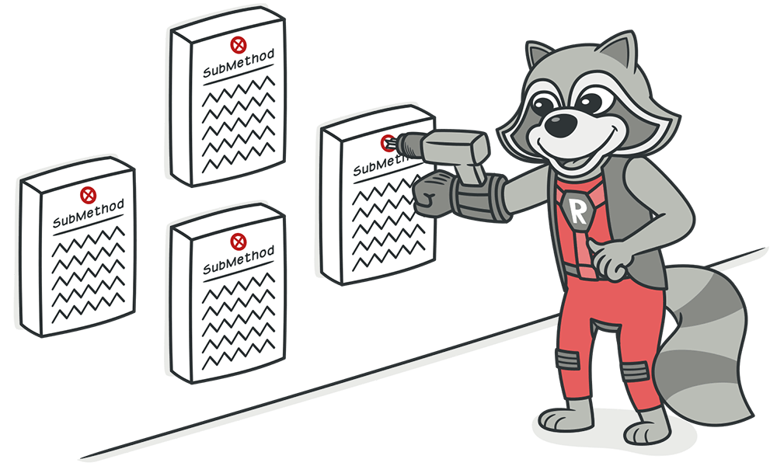
Code Smells
Long Methods
A method contains too many lines of code.
Generally, any method longer than ten lines should make you start asking questions.
Use Extract Method (Even a single line, if it requires explanation)
Performance: In almost all cases the impact of performance is so negligible that it's not even worth worrying about.

Slide 50
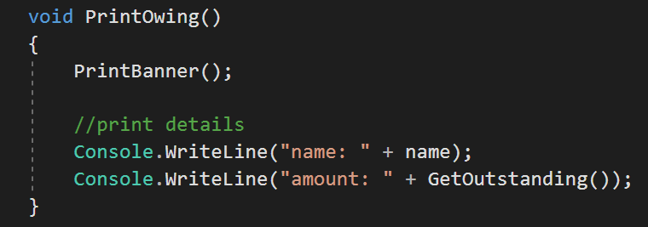
Code Smells
Extract Method (Before)
Notes:
Banner: سر صفحه و اطلاعات اولیه
Outstanding: بدهی

Slide 51
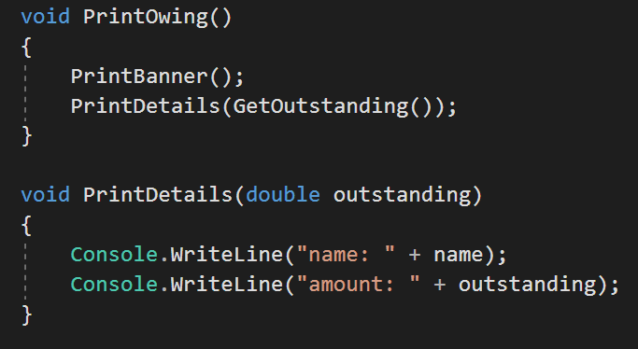
Code Smells
Extract Method (After)

Slide 52
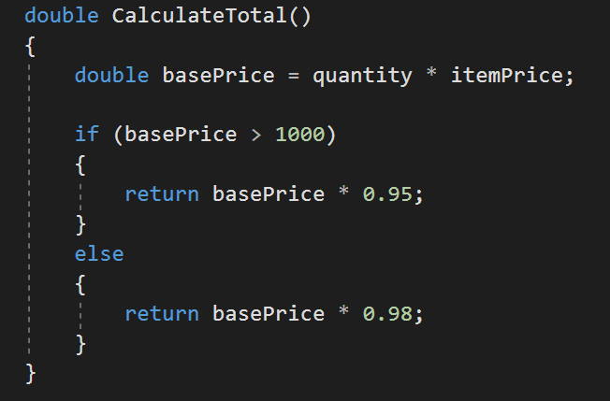
Code Smells
Replace Temp with Query (Before)

Slide 53
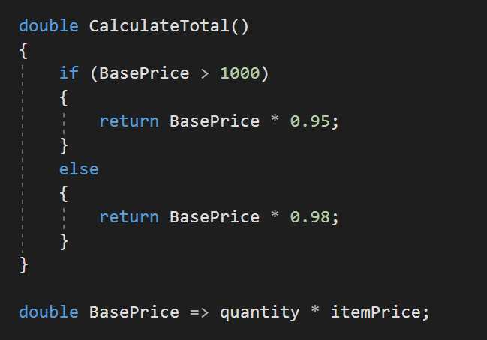
Code Smells
Replace Temp with Query (After)

Slide 54
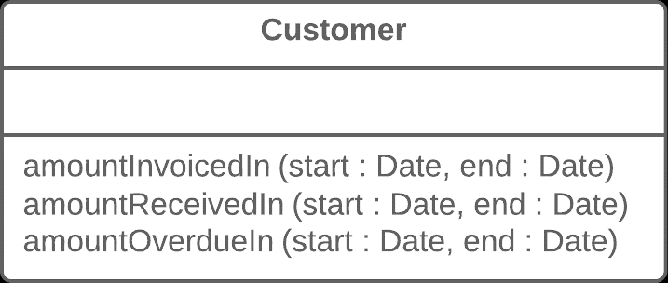
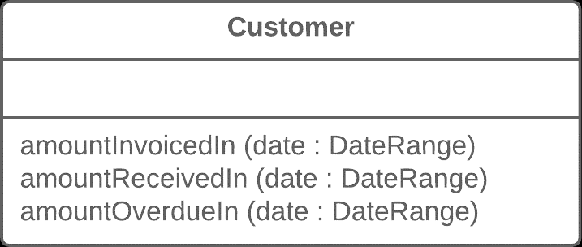
Code Smells
Introduce Parameter Object

Slide 55
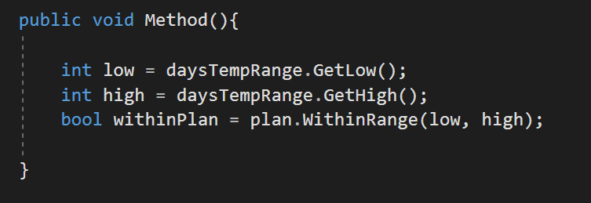
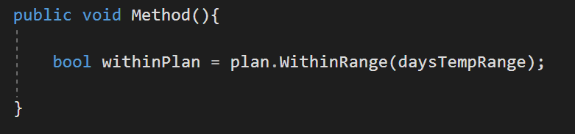
Code Smells
Preserve Whole Object
Notes:
نگه داشتن تمام شی

Slide 56
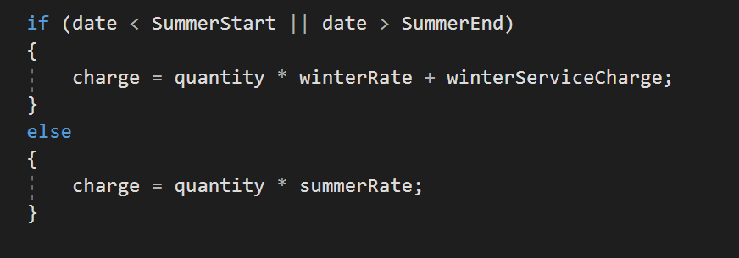
Code Smells
Decompose Conditional (Before)
Notes:
تجزیه عبارات شرطی

Slide 57
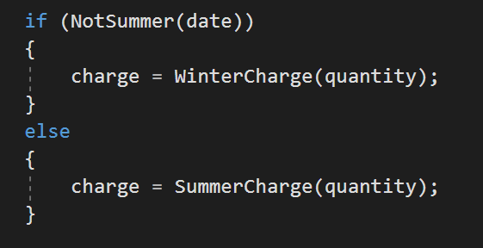
Code Smells
Decompose Conditional (After)

Slide 58
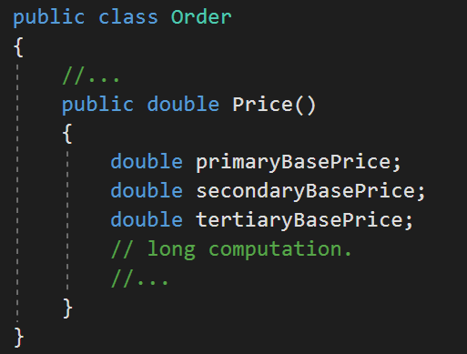
Code Smells
Replace Method with MethodObject (Before)

Slide 59
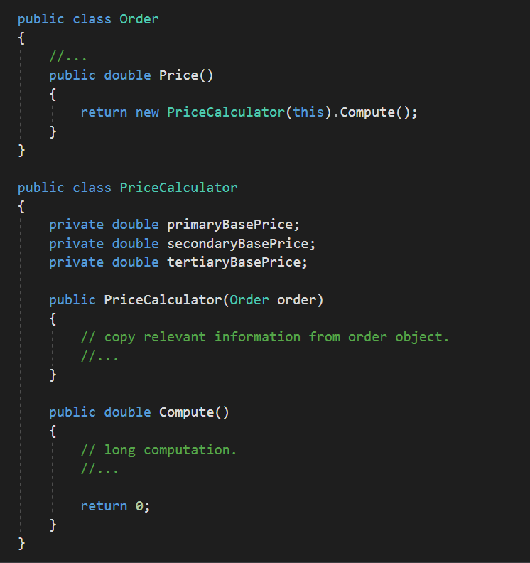
Code Smells

Slide 60
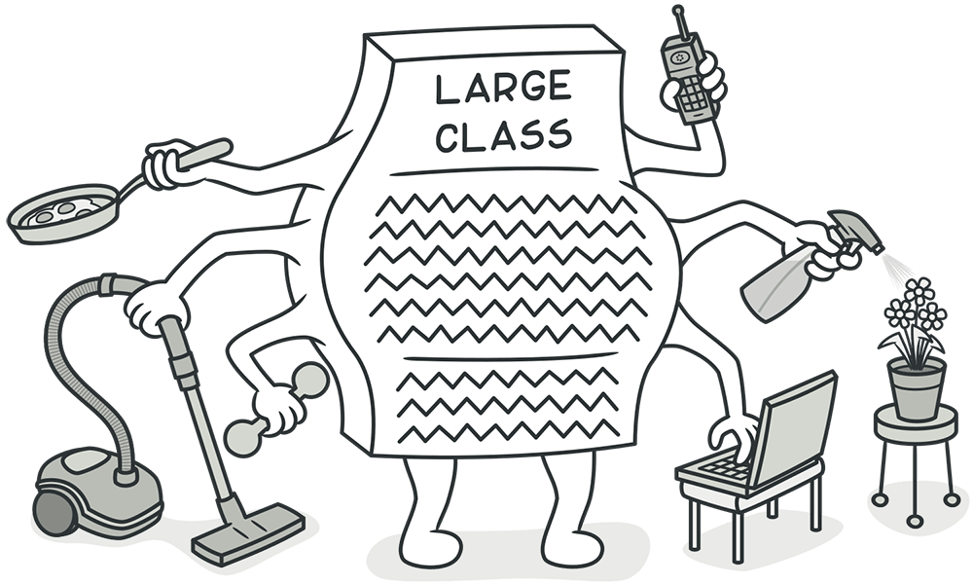
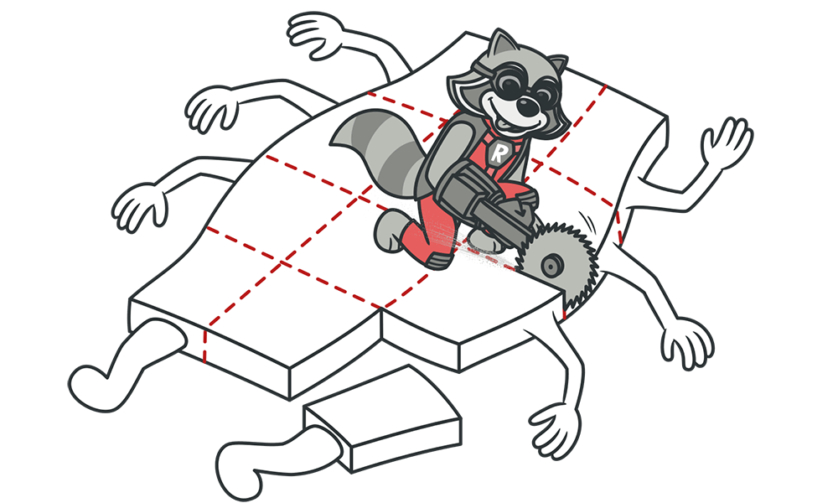
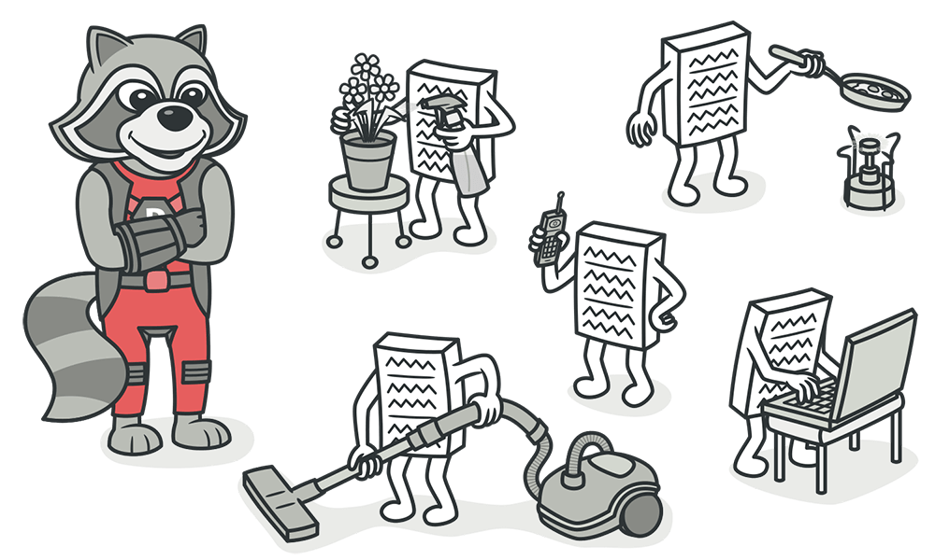
Code Smells
Large Classes
A class contains many fields/methods/lines of code.
Classes usually start small. But over time, they get bloated as the program grows.
Like long methods, programmers usually find it mentally less taxing to place a new feature in an existing class than to create a new class for the feature.
Notes:
مورد سوم: برنامه نویسا ترجیح میدن جای کلاس جدید همون کلاس قبلی رو هی بزرگش کنن

Slide 61
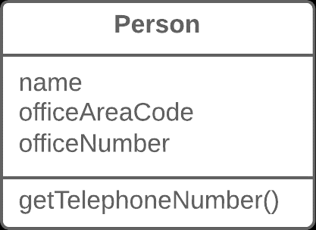
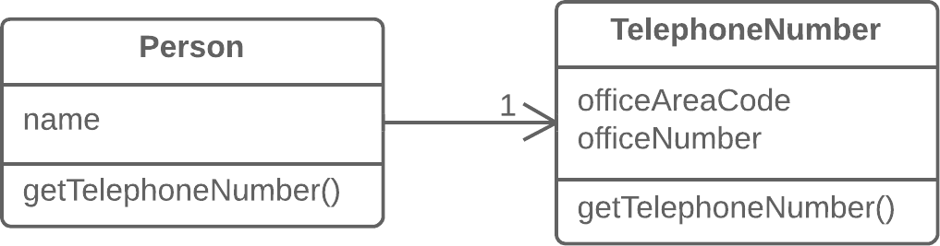
Code Smells
Extract Classes

Slide 62
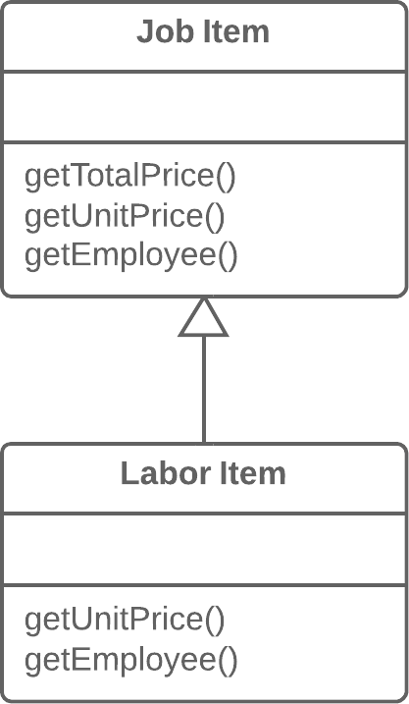
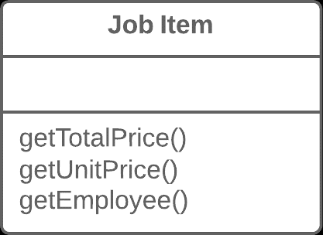
Code Smells
Extract Subclasses

Slide 63
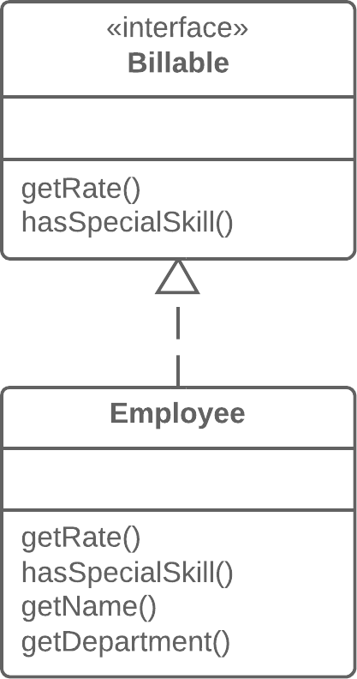
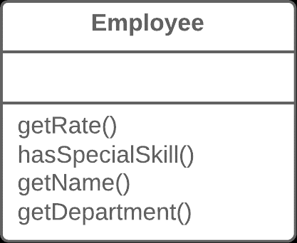
Code Smells
Extract Interface

Slide 64
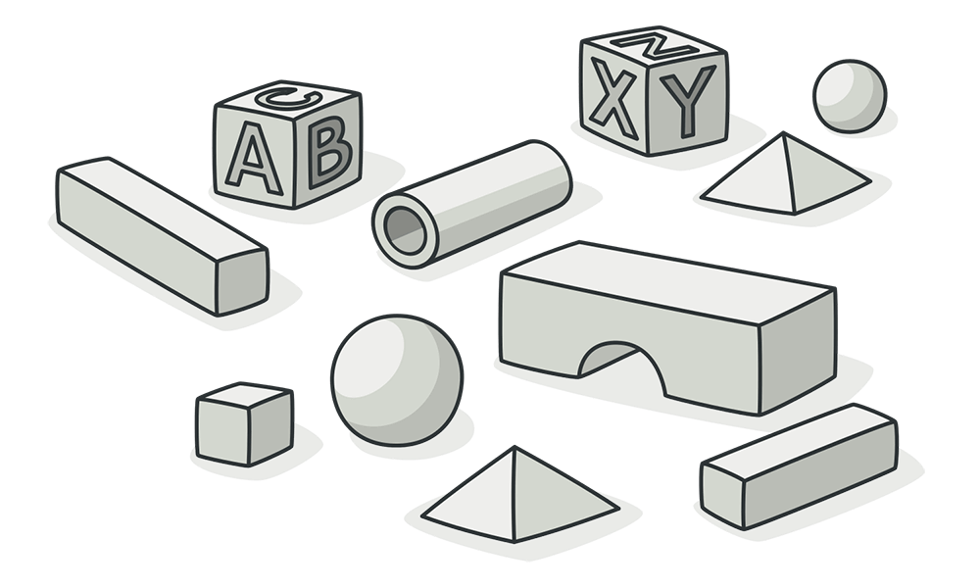
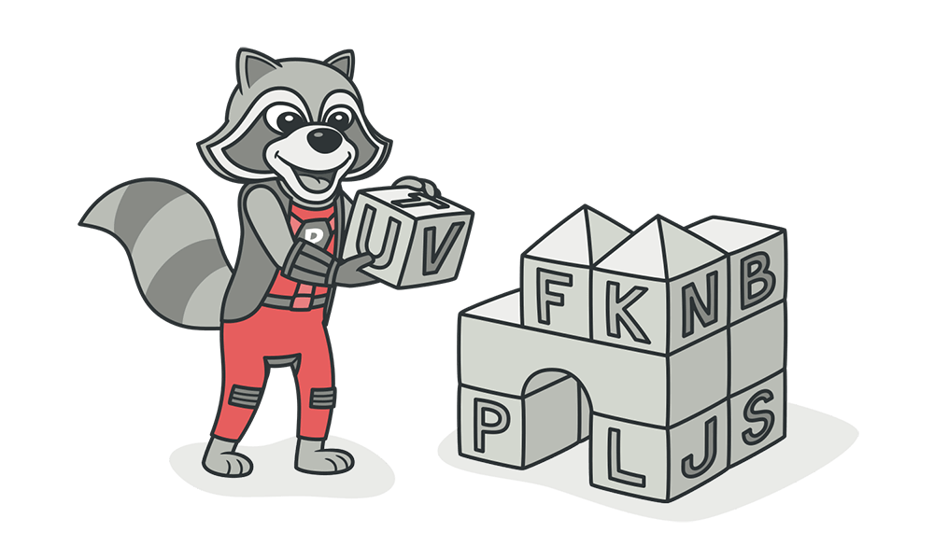
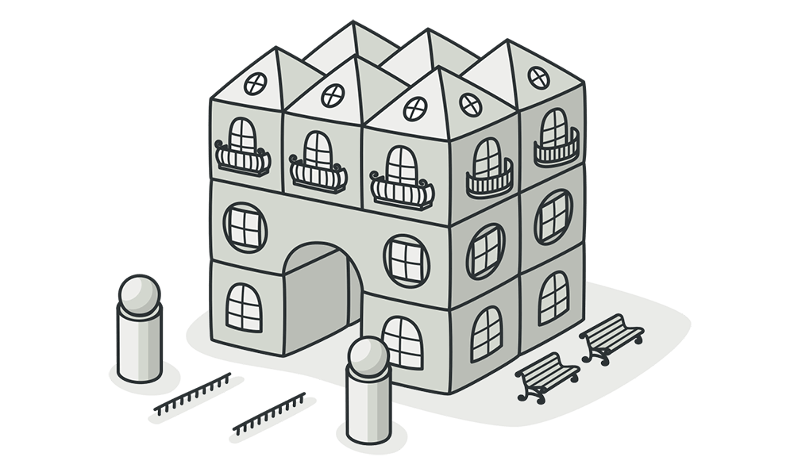
Code Smells
Primitive Obsession
Use of primitives instead of small objects for simple tasks (such as currency, ranges, special strings for phone numbers, etc.)
Use of constants for coding information (such as a constant USER_ADMIN_ROLE = 1 for referring to users with administrator rights.)
Use of string constants as field names for use in data arrays.
In method parameters you can use Introduce Parameter Object and Preserve Whole Object.
Notes:
وسواس اولیه
افرادی که تازه با اشیا اشنا شدن از استفاده از اشیا برای کار های کوچیک اجتناب میکنن

Slide 65
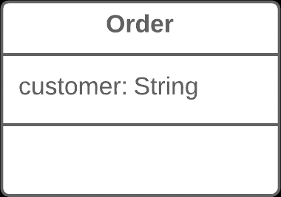
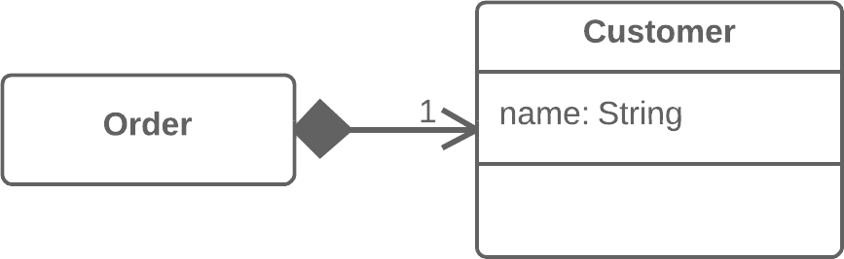
Code Smells
Replace Data Value with Object
Notes:
<.>--→ Composition (Not-Shared Association)
Can be: Aggregation

Slide 66
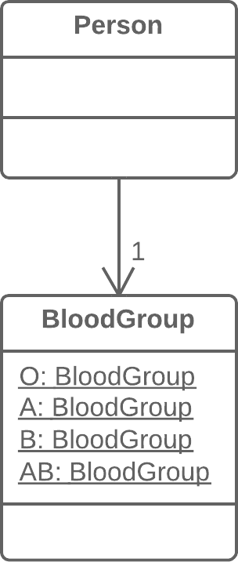
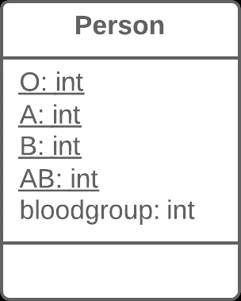
Code Smells
Replace Type Code with Class (Enum)

Slide 67
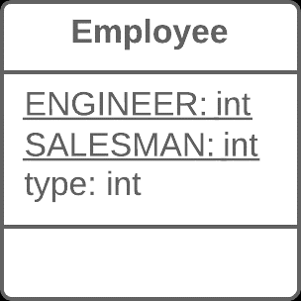
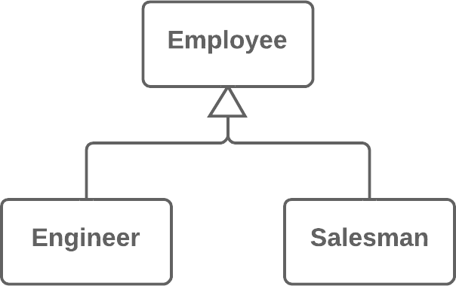
Code Smells
Replace Type Code with Subclasses

Slide 68

Code Smells
Replace Type Code with State/Strategy

Slide 69


Code Smells
Replace Array with Object

Slide 70


Code Smells
Long Parameter List
More than three or four parameters for a method.
More readable, shorter code.
Refactoring may reveal previously unnoticed duplicate code.
Do not get rid of parameters if doing so would cause unwanted dependency between classes.
You can apply Preserve Whole Object and Introduce Parameter Object.

Slide 71


Code Smells
Replace Parameter with Method Call

Slide 72



Code Smells
Data Clumps
Parts of the code contain identical groups of variables (for example: connecting to DB variables)
These clumps must be turned into their own classes.
You can apply Extract Class, Introduce Parameter Object and Preserve whole object.
Notes:
توده داده ها
چند تا متغیر میتونن یه کلاس بشن

Slide 73

Code Smells
Object-Orientation Abusers
All these smells are incomplete or incorrect application of object-oriented programming principles.
Notes:
سو استفاده کنندگان از شی گرایی

Slide 74


Code Smells
Alternative Classes with Different Interfaces
Two classes perform identical functions but have different method names.
You may be able to delete one of the classes after:
Rename Methods to make them identical in all alternative classes.
Move method, Add Parameter, Parameterize Method to make the signature and implementation of methods the same.
Extract superclass. In this case, the existing classes will become subclasses.
Notes:
احتمالا نمیدونسته کلاسی با همین کارایی وجود داشته
باید یکسان سازی بشه تا کلاس

Slide 75


Code Smells
Rename Method

Slide 76


Code Smells
Move Methods

Slide 77


Code Smells
Add Parameter

Slide 78


Code Smells
Parameterize Method

Slide 79


Code Smells
Extract Superclass
Notes:
Party بخش

Slide 80



Code Smells
Refused Bequest
If a subclass uses only some of the methods and properties inherited from its parents, the hierarchy is off-kilter
If inheritance makes no sense, use Replace inheritance with delegation.
If inheritance is appropriate, Extract superclass
Notes:
میراث به درد نخور
Replace inheritance with delegation : stack overflow question related

Slide 81


Code Smells
Replace Inheritance with Delegation

Slide 82


Code Smells
Switch Statements
You have a complex switch operator or sequence of if statements.
To isolate switch and put it in the right class, use Extract Method and then Move Method.
If it is based on type codes (enums), use Replace Type Code with Subclasses or Replace Type Code with State/Strategy.
After specifying the inheritance structure, use Replace Conditional with Polymorphism.

Slide 83

Code Smells
Replace Parameter with Explicit Methods (Before)

Slide 84

Code Smells
Replace Parameter with Explicit Methods (After)

Slide 85

Code Smells
Introduce Null Objects (Before)

Slide 86


Code Smells

Slide 87

Code Smells
Replace Conditional with Polymorphism (Before)

Slide 88


Code Smells
Replace Conditional with Polymorphism (After)

Slide 89



Code Smells
Temporary Fields
Temporary fields get their values only under certain circumstances. Outside of these circumstances, they are empty.
Put temporary fields in separate class, using Extract Class. In fact, you are creating MethodObject.
You can perform Replace Method with Method Object..
Introduce Null Object to check the temporary field values for existence.
Notes:
الگوریتمی در کلاس هست که متغیر های زیادی نیاز داره، چون میخوایم تابع رو کم پارامتر نگه داریم، به تابع فیلد اضافه میکنیم. بنابراین خیلی اوقات این فیلد ها نیاز نمیشن.

Slide 90

Code Smells
Change Preventers
These smells mean that if you need to change something in one place in your code, you have to make many changes in other places too. Program development becomes much more complicated and expensive as a result.
Notes:
ضد تغییر ها
بخوای تغییر بدی، کلی جای دیگه باید تغییر کنه

Slide 91


Code Smells
Divergent Change
You have to change many part of a class, with a single change.
For example, when adding a new product type you have to change the methods for finding, displaying, and ordering products.
Split up behavior via Extract Class.
If different classes have same behavior, combine classes with inheritance (Extract Sub or Super Class).
Notes:
تغییرات واگرا
چند تغییر در یک کلاس

Slide 92


Code Smells
Parallel Inheritance Hierarchies
Whenever you create a subclass for a class, you find yourself needing to create a subclass for another class.
De-duplicate parallel class hierarchies in two steps:
Make instances of one hierarchy refer to instances of another hierarchy
Remove the hierarchy in the referred class, by using Move Method and Move Field.
Notes:
Composition / Aggregation
Composition: Needs Parent

Slide 93



Code Smells
Shotgun Surgery
You have to make many small changes to many different classes, after a small change.
A single responsibility has been split up among a large number of classes. This can happen after overzealous application of Divergent Change.
Use Move Method and Move Field to move existing class behaviors into a single class.
If there is no class appropriate for this, create a new one.
If moving code to the same class leaves the original classes almost empty, try to get rid of these now-redundant classes via Inline Class.
Notes:
یک تغییر در چندین کلاس
زیاده روی در تغییرات واگرا

Slide 94

Code Smells
Inline Class
A class does almost nothing and is not responsible for anything, and no additional responsibilities are planned for it.

Slide 95

Code Smells
Dispensables
A dispensable is something pointless and unneeded whose absence would make the code cleaner, more efficient and easier to understand.
Notes:
بی فایده ها
نبودشون بهتره

Slide 96


Code Smells
Comments
A method is filled with explanatory comments.
The best comment is a good name for a method or class.
If a comment is intended to explain a complex expression, the expression should be split into understandable subexpressions using Extract Variable.
If a comment explains a section of code, this section can be turned into a separate method via Extract Method.
If a method has already been extracted, but comments are still necessary to explain: Rename Method
If you need to assert rules about a state that is necessary for the system to work, use Introduce Assertion.
Notes:
کامنت برای وقتیه که کد به راحتی با اسم متغیر معلوم نیست چیکار انجام میده

Slide 97


Code Smells
Extract Variable

Slide 98


Code Smells
Introduce Assertion

Slide 99



Code Smells
Duplicate Code
Two code fragments look almost identical.
Same code found in two subclass of same level?
Two subclass in the same level: Extract Method, followed by Pull Up Field.
Duplicate code inside a constructor? Use Pull Up Constructor Body.
Duplicate code is similar, but not completely identical? Use Form Template Method.
Codes does same things, but different algorithms? Select best algorithm and use Substitute Algorithm.
Same code found in two different classes?
Try to Extract Subclasses or Classes
Large conditional expressions perform the same code?
Consolidate Conditional Expression and Extract Method
Same code is performed in all branches of a conditional expression?
Use Consolidate Duplicate Conditional Fragments.
Notes:
Substitute Algorithm الگوریتم جایگزین
Consolidate یکی کردن

Slide 100


Code Smells
Pull up field

Slide 101

Code Smells
Pull Up Constructor Body (Before)
Notes:
کد تکراری در کانستراکتور

Slide 102

Code Smells
Pull Up Constructor Body (After)

Slide 103


Code Smells
Form Template Method
Notes:
شبیه اما نه کاملا یکسان

Slide 104

Code Smells
Substitute Algorithm (Before)
Notes:
الگوریتم جایگزین

Slide 105

Code Smells
Substitute Algorithm (After)

Slide 106

Code Smells
Consolidate Conditional Expression (Before)

Slide 107

Code Smells
Consolidate Conditional Expression (After)

Slide 108

Code Smells
Consolidate Duplicate Conditional Expression (Before)

Slide 109

Code Smells
Consolidate Duplicate Conditional Expression (After)

Slide 110


Code Smells
Data Class
Classes that contains only fields and crude methods for accessing them (getters and setters).
Use properties instead of public fields using Encapsulate Field.
Any data store collections? Use Encapsulate Collection.
Functionality that would be better located in the data class itself? Move Method or Extract Method.
Get rid of old method with broad access to data? Remove setting method and Hide method.
Notes:
Functionality ندارن

Slide 111


Code Smells
Encapsulate Field

Slide 112


Code Smells
Hide Method

Slide 113


Code Smells
Remove Setting Method

Slide 114


Code Smells
Dead Code
A variable, parameter, field, method or class is no longer used (usually because it is obsolete).
Quickest way: Use an IDE
Delete unneeded code
Mark code as Obsolete and remove after a breaking change.
Use Inline Class, Collapse Hierarchy, Remove Parameter.
Notes:
Functionality ندارن

Slide 115

Code Smells
Mark code as Obsolete

Slide 116


Code Smells
Lazy Class
Understanding and maintaining classes always costs time and money.
If a class doesn't do enough to earn your attention, it should be deleted.
Use Inline class and Collapse Hierarchy.

Slide 117


Code Smells
Speculative Generality
There is an unused class, method, field or parameter.
Created to support anticipated future features that never get implemented.
Use Inline class, Collapse Hierarchy, Inline Method, Remove Parameter.
Unused fields can simply be deleted.
Notes:
عمومیت خطرناک
کد برای استفاده آینده نوشته میشه، ولی هیچ وقت پیاده سازی نمیشن

Slide 118

Code Smells
Couplers
All the smells in this group contribute to excessive coupling between classes or show what happens if coupling is replaced by excessive delegation.

Slide 119



Code Smells
Feature Envy
A method accesses the data of another object more than its own data.
If a method clearly should be moved to another place, use Move Method.
If only part of a method accesses the data of another object, use Extract Method to move the part in question.
Notes:
حسادت به ویژگی ها

Slide 120



Code Smells
Inappropriate Intimacy
One class uses the internal fields and methods of another class.
Simplest solution, use Move Method and Move Field.
If the classes are mutually interdependent, you should use Change Bidirectional Association to Unidirectional.
If this "intimacy" is between a subclass and the superclass, consider Replace Delegation with Inheritance.
Notes:
صمیمیت نامناسب

Slide 121


Code Smells
Change Bidirectional Association to Unidirectional

Slide 122


Code Smells
Replace Delegation with Inheritance

Slide 123


Code Smells
Incomplete Library Class
Sooner or later, libraries stop meeting user needs.
The only solution to the problem – changing the library – is often impossible since the library is read-only.
To introduce a few methods to a library class, use Introduce Foreign Method.
In C# syntax, you can use Extension Methods.
For big changes in a class library, use Introduce Local Extension.

Slide 124

Code Smells
Introduce Foreign Method (Before)

Slide 125


Code Smells
Introduce Foreign Method (After)

Slide 126

Code Smells
Introduce Local Extensions

Slide 127



Code Smells
Message Chains
In code, you see a series of calls like this: A().B().C().D()…
To delete a Chain, use Hide Delegate.
Why the end object is being used?
Extract Method for this functionality, and then
Move it to the beginning of the chain, by using Move Method.

Slide 128


Code Smells
Middle Man
If a class performs only one action, delegating work to another class, why does it exist at all?
This smell can be the result of overzealous elimination of Message Chains.
If most of a method's classes delegate to another class, Remove Middle Man is in order.

Slide 129
Resources

Slide 130
Resources
Resources
Fowler, Martin (1999). Refactoring. Improving the Design of Existing Code. Addison-Wesley. ISBN 0-201-48567-2.
Refactoring Guru
Arsenovski, Danijel (2009). Professional Refactoring in C# and ASP.NET. Wrox. ISBN 978-0-470-43452-9.
Ritchie, Peter (2010). Refactoring with Visual Studio 2010. Packt. ISBN 978-1-84968-010-3.

